Slide 1
UNIT-1
MARKETING MANAGEMENT
Presented by:-
Ms.Monalisa Khatre

Slide 2
Marketing
Management
Philosophies
The role that marketing plays within a company varies according to the overall strategy and philosophy of each firm.

Slide 3
Marketing Concepts
  Production concept
  Product concept
  Selling concept
  Marketing concept
  Societal marketing concept
  Holistic Marketing Concept

Slide 4

Holistic Marketing concept
Societal Marketing Concept
Marketing Concept
Selling Concept
Product Concept
Production Concept

Slide 5

Oldest concept
Consumers prefer products widely available & inexpensive
Management focus:
- achieving high production efficiencies
- low costs
- mass distribution
More appropriate in developing economies
Also appropriate when consumer wants to expand market

Slide 6
This philosophy, though not popular today, would still be relevant for very basic commodities such as salt, public utilities like water and electricity and mass urban transportation
.
This orientation is still relevant in developing economies, where standard of living is lower, and large population is the first time consumer of even basic products like soaps, toothpaste etc.
The vast rural economy of India is one such market.
For example
Tata salt, lux, colgate

Slide 7

Consumers will favour those products that offer the most quality, performance, and innovative features.
The organization should devote its energy in improving product quality
mobile laptops i-pad i-phone

Slide 8

The Selling Concept is a management orientation that assumes that consumers will either not buy or not buy enough of the organisation’s products unless the organization makes a substantial effort to stimulate their interest in its products through marketing and promotion.
Examples of Where the Selling Concept is practiced:
“unsought goods” i.e. those goods that buyers normally do not think of buying.
Examples : * insurance * encyclopedias and * funeral plots
Nonprofit areas: *Political Parties *Churches

Slide 9

The marketing concept holds that the key to achieving organizational goals consists of the organization’s determining the needs and wants of target markets and adapting itself to delivering the desired satisfactions more effectively and efficiently than its competitors.
Examples of companies Practicing marketing Concept
Nokia priority nokia care
Debit credit cards
datacard
Procter and Gamble

Slide 10
Knowledgeable and sophisticated customers today have highly individualized want and want customized solutions.
Wide penetration of broadband connectivity and access to internet through variety of handheld devices.
Advent of electronic payment mechanisms to support financial transactions
The internet and CRM technologies have enabled companies to capture real time data about individual customer and to track their preferences, purchases and usage pattern over time.

Slide 11

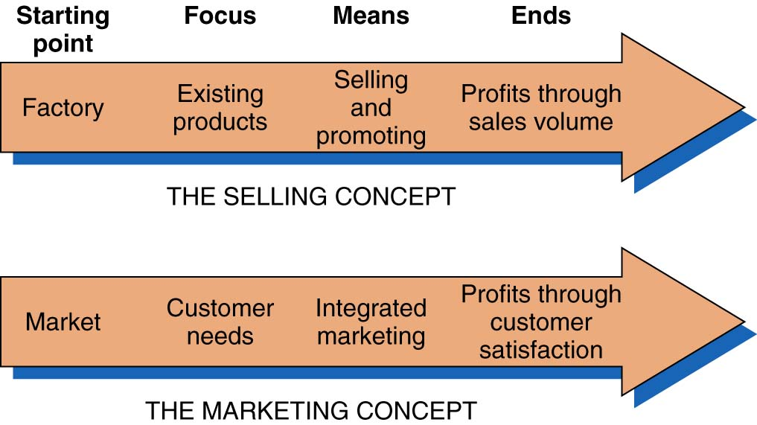

Slide 12

The idea that the organization should determine the needs, wants, and interests of target markets and deliver the desired satisfactions more effectively and efficiently than competitors in a way that maintains or improves the consumer’s and society’s well – being.
Corporation like Sony and Microsoft, leaders in gaming industry have come under severe criticism at it is believed that their very popular games glorify and promote violence. Companies that practice this concept take their Corporate Social Responsibility (CSR) very seriously to prove good corporate citizenship

Slide 13

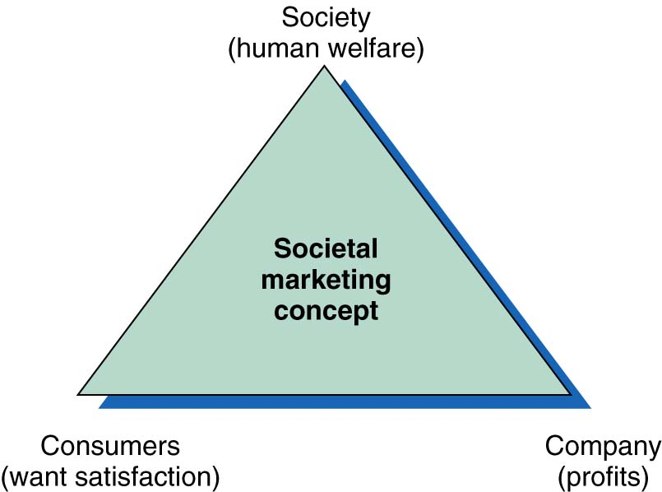

Slide 14

When all the company’s departments work together to serve the customer’s interests, the result is integrated marketing:
Integrated marketing takes place at two levels:
Various marketing functions work together
Marketing must be embraced by other departments
to foster teamwork among all departments,
Company carries out:
External marketing
Internal marketing

Slide 15

Relationship marketing has the aim of building mutually satisfying long-term relationships with key parties in order to earn & retain their businesses
Marketing must not only do customer relationship management, but also partner relationship management
4 key constituents of marketing are
customers
employees
marketing partners
members of the financial community

Slide 16

It is the task of hiring , training and motivating able employees who want to serve customers well.

Slide 17

Based on development, design, & implementation of marketing programmes, processes & activities that recognize their interdependencies
Holistic marketing recognizes that “everything matters” with marketing & that a broad, integrated perspective is often necessary
4 components of holistic marketing:
  Relationship marketing
  Integrated marketing
  Internal marketing
  Social responsibility marketing

Slide 18

Senior management Products & Services
Marketing Other Communication Channels
department departments
Internal marketing Integrated marketing
Holistic Marketing
Societal marketing Relationship marketing
Legal Environment Community Customer Partner
Ethics Channel

